Slide 1
All Mortality and COVID-19 Mortality – Source: ONS (Death Registrations) – up to Week 48
This data is based upon death registrations at register offices. COVID-19 or Coronavirus was mentioned as a cause of death on any line of the death certificate in relation to COVID-19 Deaths. This is not the same data that is published on the government website as this data is not linked to COVID-19 test results.

Slide 2
All Mortality and COVID-19 Mortality – Source: ONS (Death Registrations) – up to Week 48
This data is based upon death registrations at register offices. COVID-19 or Coronavirus was mentioned as a cause of death on any line of the death certificate in relation to COVID-19 Deaths. This is not the same data that is published on the government website as this data is not linked to COVID-19 test results.

Slide 3
COVID-19 Mortality – Source: ONS (Death Registrations) – Week 11 (no known COVID-19 Deaths in Bury before this point) up to Week 48 by Place of Death Occurrence
This data is based upon death registrations at register offices. COVID-19 or Coronavirus was mentioned as a cause of death on any line of the death certificate in relation to COVID-19 Deaths. This is not the same data that is published on the government website as this data is not linked to COVID-19 test results.

Slide 4
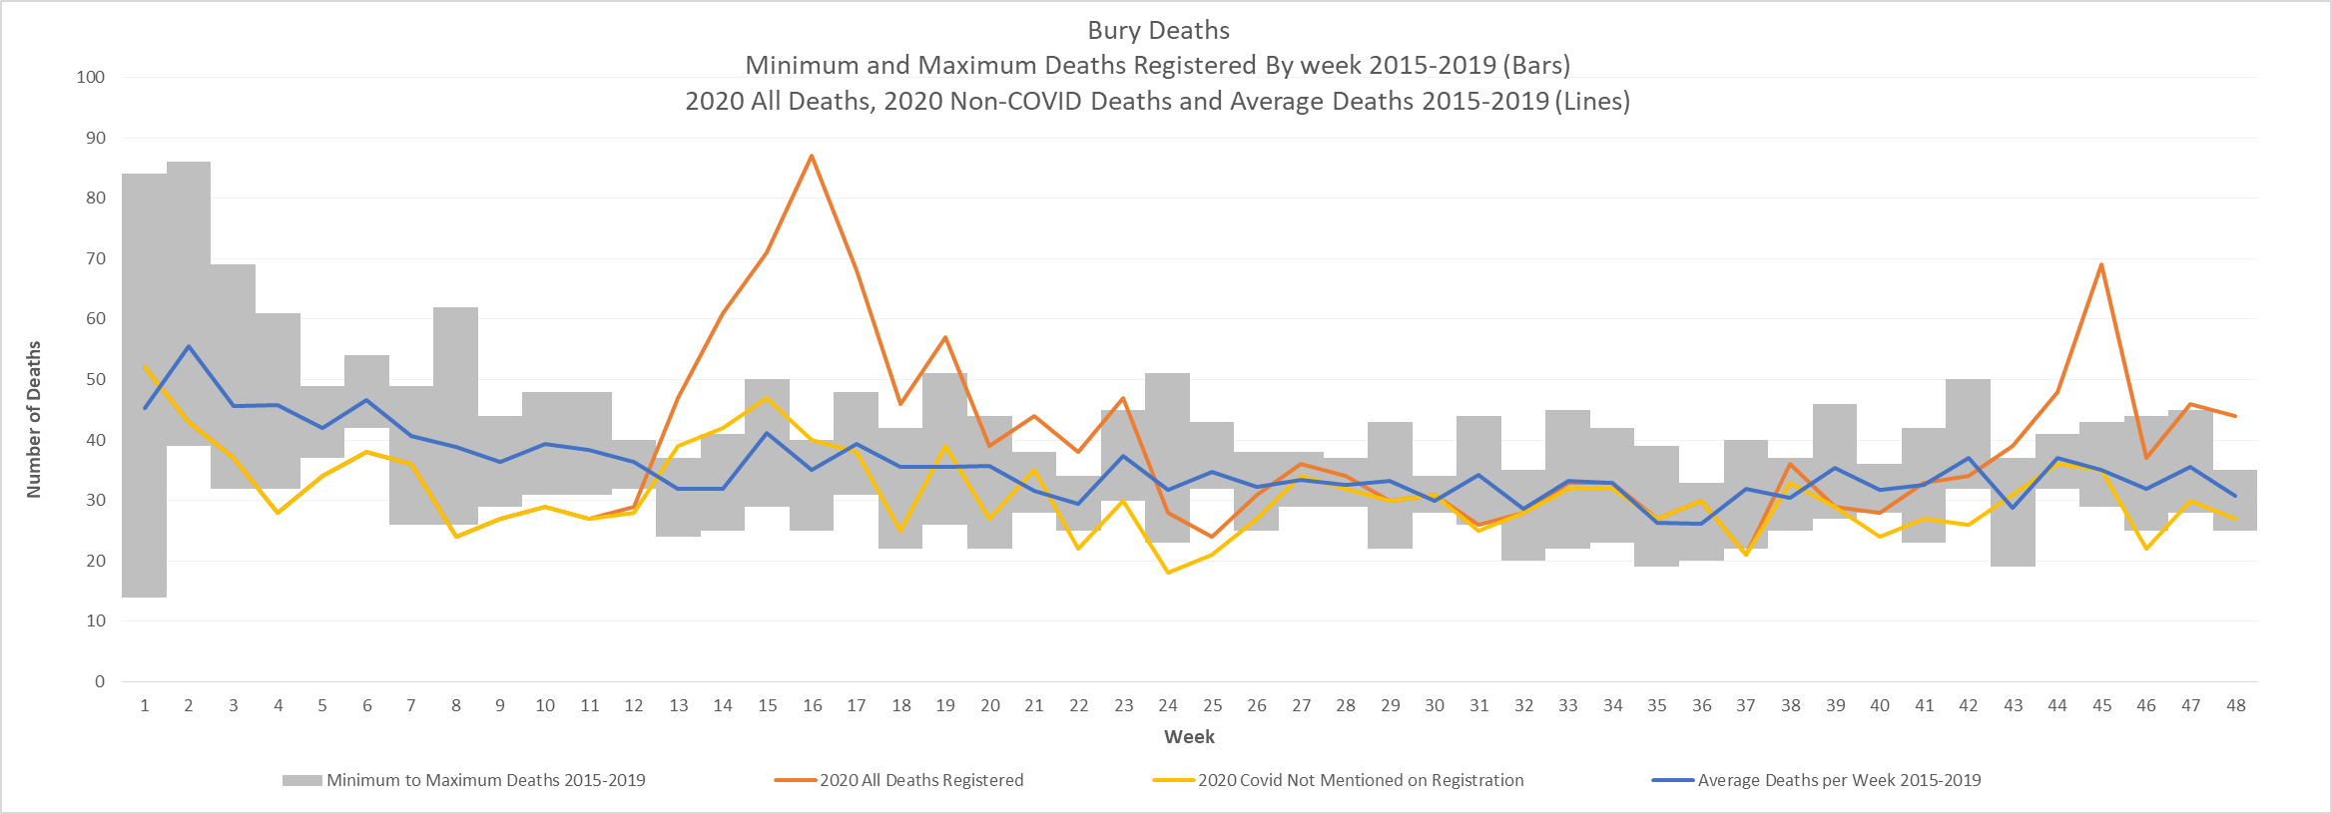
COVID-19 Excess Deaths –
Source: ONS and Primary Care Mortality Database (PCMD)
The below graph highlights, the number of deaths registered by week, with the minimum deaths and the maximum deaths registered in the given week, between 2015-2019, taken from the PCMD database. This is displayed as bars, which would give a range in which we would expect to see deaths. In regards to the lines, 2020 figures (from ONS) from all deaths and non-covid-19 deaths are displayed along with the average of 2015-19 deaths as a comparison. As displayed the first peak can be seen between weeks 13 to 23, and now there has been an emergence of another peak from week 43 onwards.
Weeks rather than dates are referred to on this graph as the dates within a given week change year on year, whereas the week numbers stay consistent.

Slide 5
Historic Ward Cases - Number of Cases by Week (Weeks 33-40) Weeks since first COVID-19 case in Bury 28/02/2020 (based on when the positive test was taken).
The weeks run Friday to Thursday to allow for the data lag from PHE.
During week 35 – 23rd October 2020 Tier 3 Measures introduced across Greater Manchester.
Week 37 – National Circuit Breaker Lockdown.
RAG rating (colour of boxes) – This is to show hotspots each week, so is not based on thresholds. It is a scale of Red = highest cases/rates to green lowest cases/rates each week

Slide 6
Historic Ward Rates – Rate per 100,000 by Week (Weeks 33-40) Weeks since first COVID-19 case in Bury 28/02/2020 (based on when the positive test was taken).
The weeks run Friday to Thursday to allow for the data lag from PHE.
During week 35 – 23rd October 2020 Tier 3 Measures introduced across Greater Manchester.
Week 37 – National Circuit Breaker Lockdown.
RAG rating (colour of boxes) – This is to show hotspots each week, so is not based on thresholds. It is a scale of Red = highest cases/rates to green lowest cases/rates each week

Slide 7
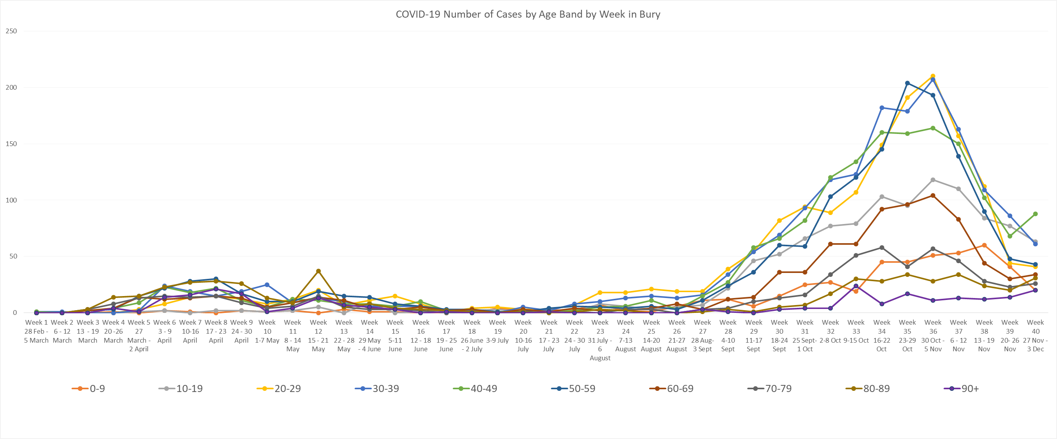
Historic Age Trends – Up to 26/11/2020 Weeks since first COVID-19 case in Bury 28/02/2020 (based on when the positive test was taken).
The weeks run Friday to Thursday to allow for the data lag from PHE.
The graphs highlight the trend over time of each age band (in 10 year grouping).

Slide 8
Historic Age Trends, Rates per 100,000 – Up to 26/11/2020 Weeks since first COVID-19 case in Bury 28/02/2020 (based on when the positive test was taken).
The weeks run Friday to Thursday to allow for the data lag from PHE.
The graphs highlight the trend over time of each age band (in 10 year grouping).

